Slide 1
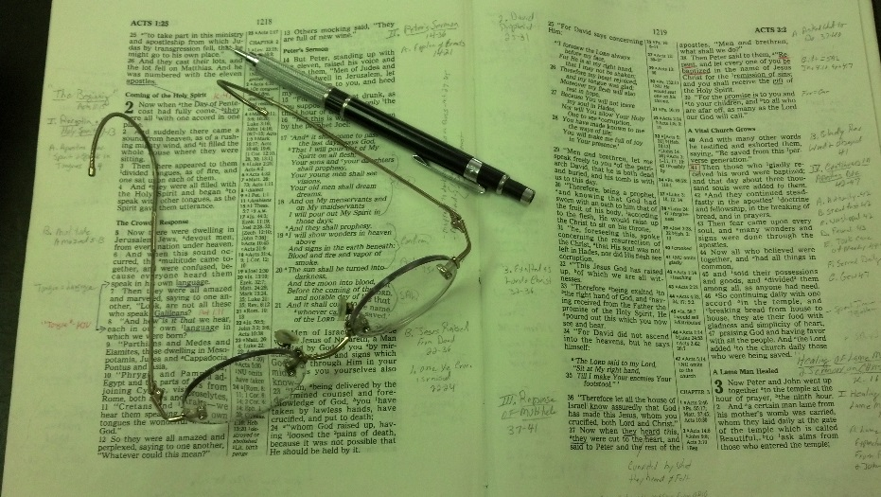
Topics
Friday: The Earnest Cry of Bartimaeus

Slide 2
Zephaniah 1:12
“And it shall come to pass at that time
That I will search Jerusalem with lamps,
And punish the men
Who are settled in complacency,
Who say in their heart,
‘The Lord will not do good,
Nor will He do evil.’”

Slide 3
Zephaniah 1:12
“And it shall come to pass at that time
That I will search Jerusalem with lamps,
And punish the men
Who are settled in complacency,
Who say in their heart,
‘The Lord will not do good,
Nor will He do evil.’”
Sin & Causes
Downfall of Judah
Could You Be
Complacent?
Settled in Complacency?

Slide 4
Settled
in
Complacency
(Zeph. 1:12)

Slide 5
Settled in Complacency
(Zeph. 1:12)
The Phrase

Slide 6
The Phrase
Translations

Slide 7
“Settled in complacency” (NKJV)
NKJV fn. “Lit. on their lees; like the dregs of wine”
ESV – “men who are complacent” fn. Hebrew are thickening on the dregs [of their wine]
KJV & ASV – “settled on their lees”
NASB95 – “Stagnant in spirit”
HCSB – “men who settle down comfortably”
NIV – “who are complacent who are like wine left on its dregs”
NRSV – “who rest complacently on their dregs”
NLT – “sit complacent in their sins”
Lexham – “Whose senses are dulled from drinking”
NET – “entrenched in their sins”
RSV – “thickening upon their lees”
YLT – “hardened on their preserved things”

Slide 8
The Phrase
Translations
Refers to fermentation process of wine
Jeremiah 48:11
Moab has been at ease from his youth; He has settled on his dregs, And has not been emptied from vessel to vessel, Nor has he gone into captivity. Therefore his taste remained in him, And his scent has not changed.

Slide 9
I will punish the men who are thickening upon their lees: the Hebrew metaphor is drawn from the process of wine-making. When the wine has fermented, it has to be poured from one vessel to another to separate the wine from the sediment which is called lees. This process is described in Jeremiah 48:11. If this is not done, the wine becomes too sweet and spoils. The verb translated thickening means “condense” or “congeal.” The men who are thickening upon their lees are people who have enjoyed uninterrupted wealth for too long and have thus become “self-satisfied and confident” (tev). “Self-satisfied” can be rendered idiomatically in many languages; for example, “filled-up-breast-filled-up-heart.” “Confident” can be translated as “trusting in oneself completely.” Material prosperity has made such people forgetful of God and led them to say in their hearts that the Lord has no interest in them. In cultures where winemaking is a well-known process, one may be able to keep the Hebrew figure of speech. Otherwise, it will be better to follow the example of tev and use nonfigurative language.
Clark, D. J., & Hatton, H. A. (1989). A translator’s handbook on the book of Zephaniah (p. 156). New York: United Bible Societies.

Slide 10
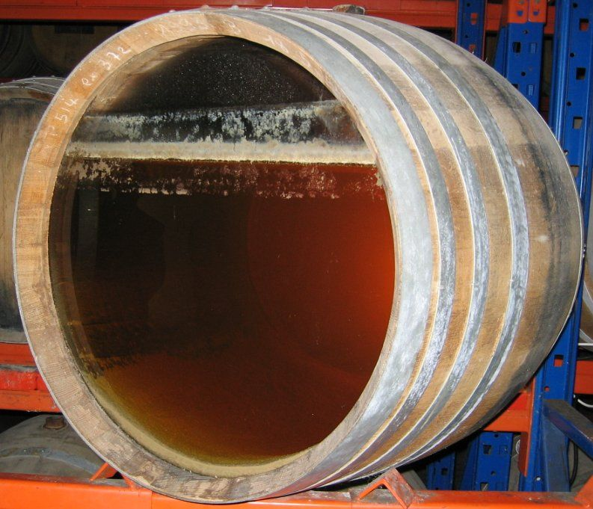
Lees / Dregs

Slide 11
The Phrase
Translations
Refers to fermentation process of wine
The point
Are indifferent – spiritually stagnant
Are satisfied (settled – not moving)
Comfortable in present condition – even though …
God’s people often warned about complacency:
Prov. 1:32
Isa. 32:9-11
Amos 6:1-6
Lam. 1:12
Isa. 57:1

Slide 12
Settled in Complacency
(Zeph. 1:12)
The Phrase
The Context

Slide 13
The Context
Message of book: Day of the Lord is coming
1:7, 14, 18
Destruction (1:2, 17)

Slide 14
The Context
Message of book: Day of the Lord is coming
Their complacency
Divided loyalty (1:5)
Unconcerned & indifferent (1:6)
Says Lord will not do good or evil (1:12)
Trust in economy going well (1:13, 18)
Not obeyed – received correction – not drawn near (3:2)
Know no shame (3:5)

Slide 15
Settled in Complacency
(Zeph. 1:12)
The Phrase
The Context
The Application

Slide 16
The Application
Are you comfortable & satisfied?
Even though you are still practicing sin (Rom. 6)?
Even though miss a lot of services?
May start as an occasional absence
May even bother us at first – then adjust to idea
With each time – gets easier
Missing out on occasion to worship God, learn his word & be edified (Heb. 10:25; Eph. 5:19)
Do you miss about half of services or more – when it is within your control?

Slide 17
The Application
Are you comfortable & satisfied?
Even though you are still practicing sin (Rom. 6)?
Even though miss a lot of services?
Even though you’re lacking in spiritual interest?
Don’t have a burning zeal (Luke 24:32)
Worship and service is merely routine
Not craving the word (1 Pet. 2:1-2; Psa. 119)

Slide 18
The Application
Are you comfortable & satisfied?
Even though you are still practicing sin (Rom. 6)?
Even though miss a lot of services?
Even though you’re lacking in spiritual interest?
Even though you are consumed with secular interest?
Jobs, education, material matters outweigh the spiritual
Cares of this world crowds out the spiritual – we don’t have time…

Slide 19
The Application
Are you comfortable & satisfied?
Do you believe it matters how serious you are?
Judah didn’t think it mattered (Zeph. 1:12)
If sin or neglect – will not be punished
If I’m diligent – will not be blessed any more
Some Christians live as if it doesn’t matter
God rewards those that diligently seek him (Heb. 11:6)

Slide 20
The Application
Are you comfortable & satisfied?
Do you believe it matters how serious you are?
Are you inactive?
Are you not growing (2 Pet. 1:5-10; 3:18)?
Are you not worshiping all the time (Heb. 10:25)?
Are you not fighting the battle (Eph. 6:10ff)?
If you are inactive:
Faith is dead (Jas. 2:14-26)
Hearer and not a doer (Jas. 1:22-25)

Slide 21
The Application
Are you comfortable & satisfied?
Do you believe it matters how serious you are?
Are you inactive?
Are you not willing to change?
Settled?
Like the way you are?
Do you ever think, “Maybe I could be stronger”?
Don’t see any real need to change (Psa. 55:19)
Heart becomes hard and calloused (Heb. 3:7, 13)

Slide 22
Settled in Complacency
(Zeph. 1:12)
The Phrase
The Context
The Application

